Slide 1

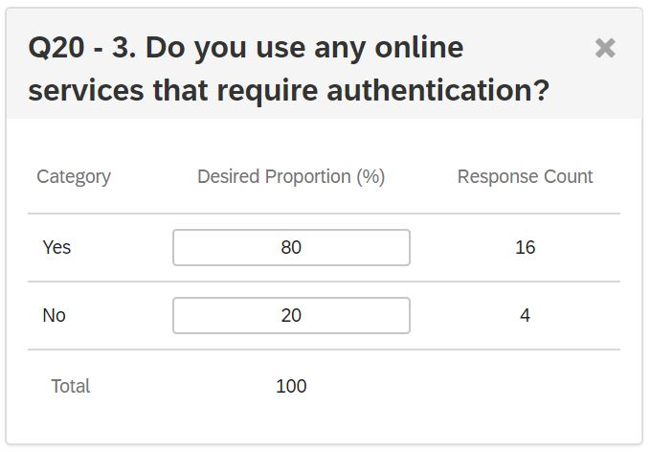
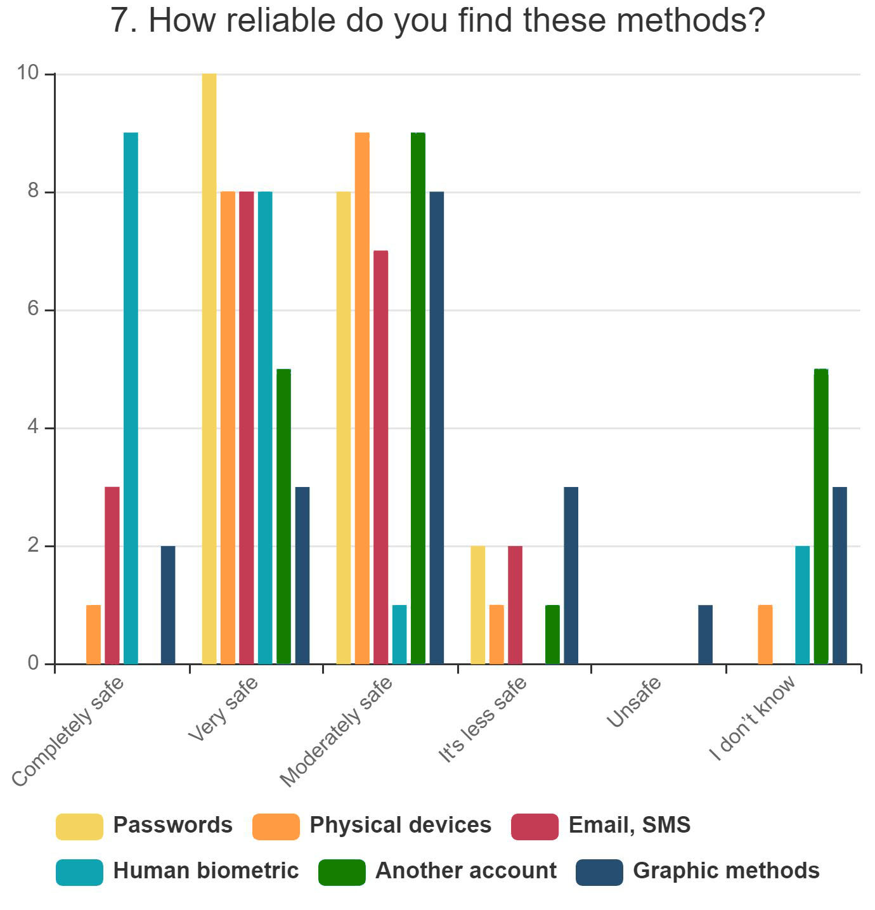
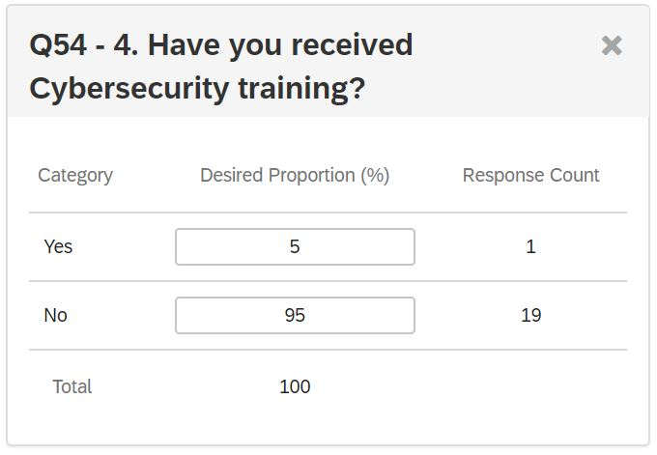
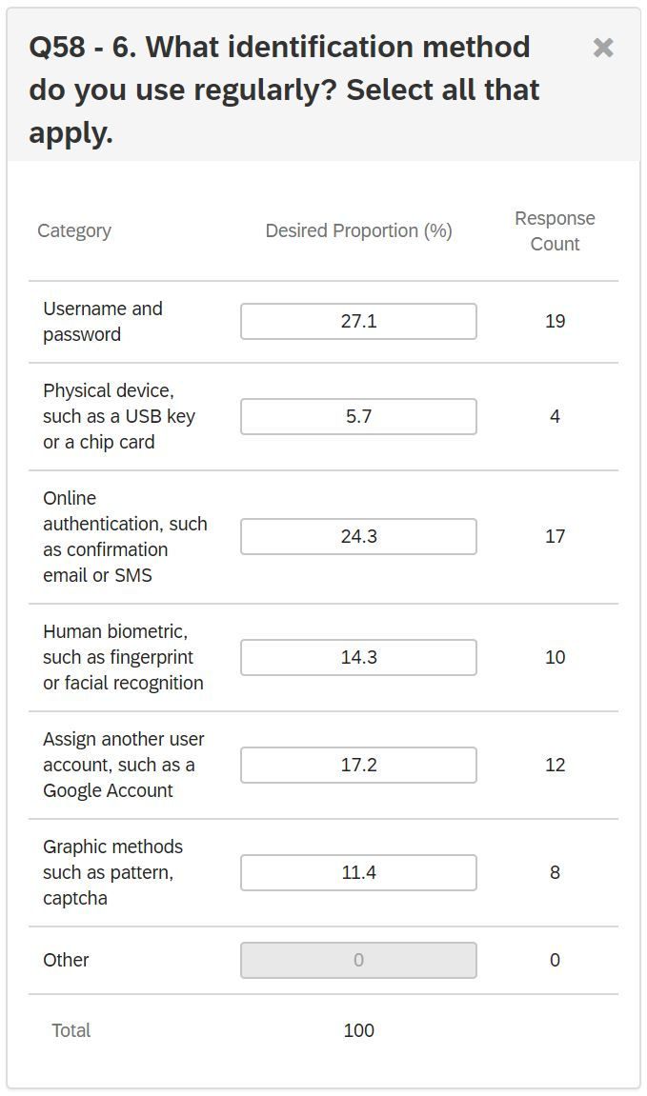
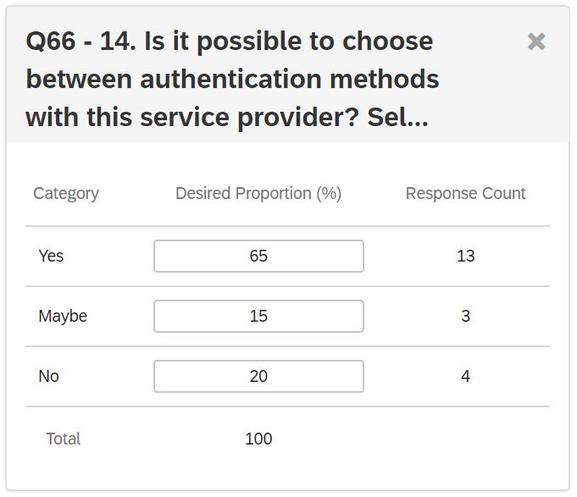
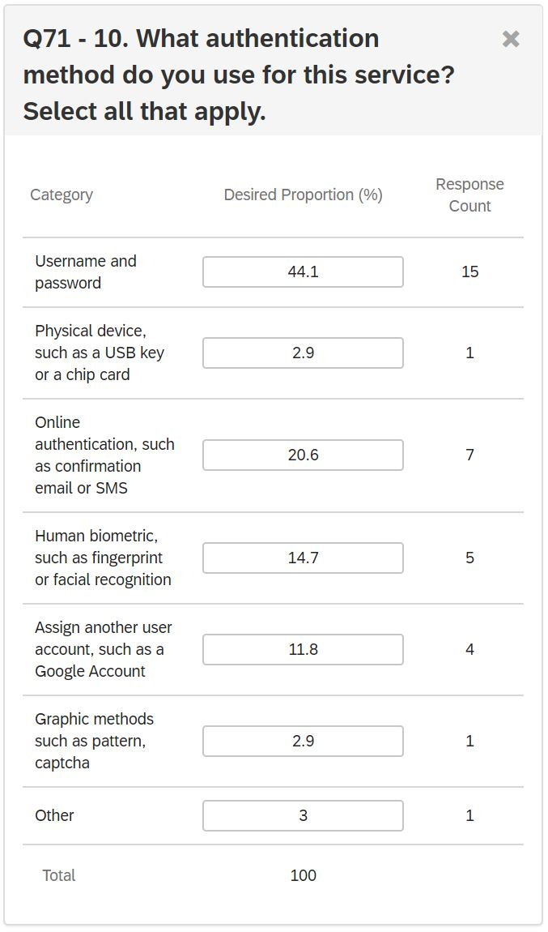
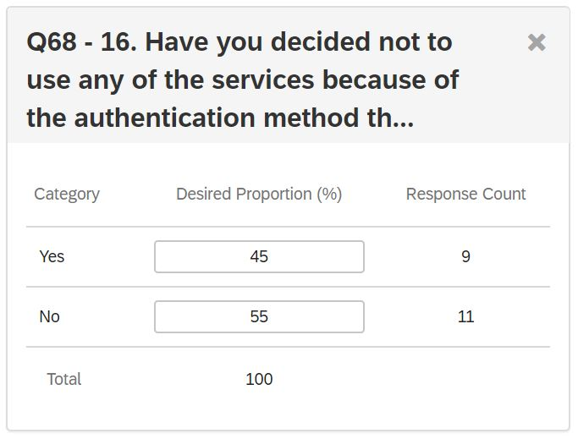
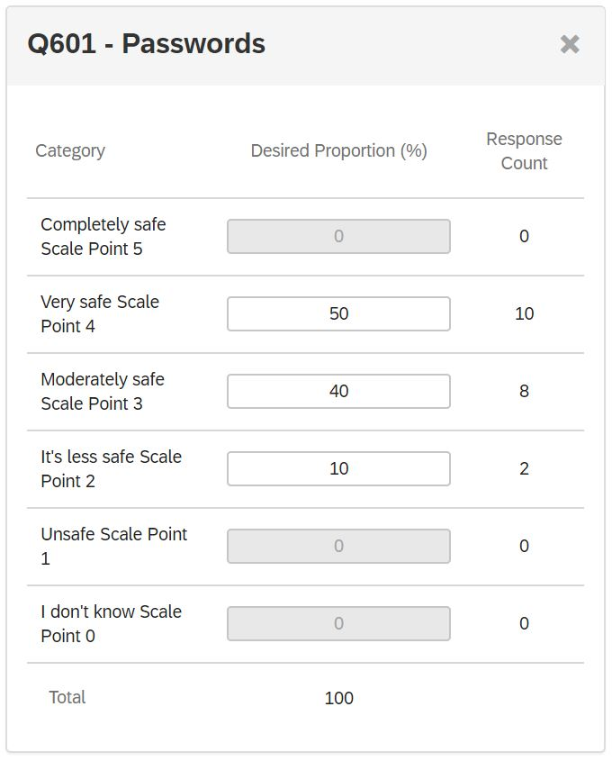
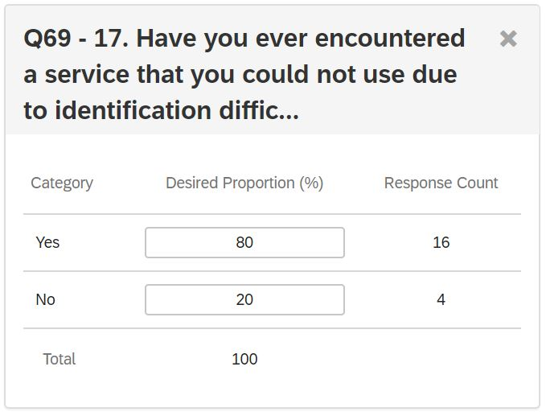
I
Multi-factor authentication from user perspective:
- How identification methods influence propensity
Istvan Franko, MSc Cyber Security
University of Sunderland
Aims
Results
Discussions
The basic aim of the survey was to take a snapshot of users ’habits and experiences with online identification methods. Then, by analysing the collected data, it reveals the shortcomings and formulates recommendations for the operation of more efficient and thus more secure systems.
This was the main research question:
How do the identification methods defined by the services affect user willingness and habits?
Conclusion
The survey confirmed that there are significant gaps in the identification methods offered by service providers and in the provision of information to users. Almost all of the users have already encountered a service that they could not or did not want to use due to the authentication method.
Some users are unaware of what is included in online identification services and most have not received cyber security training.
The level of security is not the primary consideration when selecting the most commonly used methods. And they do not at all reflect the distrust of passwords most exposed to malicious attacks, which also shows a lack of awareness.
Also, only a minority of users are sure that they have been informed about the effectiveness of the different methods. Most of them were indecisive or sure they didn’t get it.
Also about the choices, one-third of the participants were unsure or unaware of whether they had the option to choose another identification method.
Almost all of the findings listed above have led to the conclusion that the biggest gap is in the area of information and related knowledge, so this should be changed first.
The age of the 20 participants was distributed between 16 and 55 years in almost equal proportions by age group. There was only one participant in the 56-65 age group. The proportion of men and women was 65-35%, meaning nearly two-thirds of them were men.
The evaluation of the reliability of the methods according to the participants is shown in Fig. 6. From this, it can be concluded that the password is considered very or sufficiently secure by the majority and that most people consider it completely secure by Human Biometrics. But many are unaware of the level of security of certain methods
The first interesting data is shown in Fig. 1. Although participants were only able to participate with a link placed on a portal that required online identification, one-fifth stated that they did not use such a service.
Methodology
Participants
Participants were not restricted for representative results. Anyone who turned 16 and had online authentication experience could participate voluntarily. This was guaranteed by the fact that the invitation to participate was advertised on known social networks.
Figure 1.
It is also interesting to note that 95% of the participants did not receive any Cybersecurity training, see in Fig 2.
Design
The snowball procedure was chosen as the sampling strategy, so all participants were invited to involve additional participants.
The survey questions, along with the information page and the statement of participation, were created in the Qualtrics system, with access provided by the university.
The first version was presented to the project supervisor and as it took too long to complete it had to be significantly shortened. Also, some issues were not clear so they had to be reworded.
The length of the second version was already adequate so 4 invited participants were invited for a pilot test. As this version was already considered usable, it was transferred as a final version.
An additional 20 individuals participated in the final survey and only their responses were analysed.
Due to the optimization of the analysis, most of the questions were multiple choice, but a Likert Scale question structure was also used. Each of the questions was suitable for statistical analysis.
Figure 2.
The data in Figure 3 yielded the expected result, i.e., participants use almost all identification methods. The two leading methods were password and online authentication. Human biometric and other accounts were moderately featured, while graphical methods and other physical means were used the least.
Figure 6. Created on Online.visual-paradigm.com. 2020
For the briefings received on identification methods, only 30% of participants were sure they had received briefings, 60% were unsure, while 10% said they had not received anything. Of those who were sure they received, 83% were very satisfied.
Limitations
The propensity to complete online questionnaires is determined by its completion time, which should not exceed 10 minutes and therefore only a limited number of questions could be used.
Text responses to other options revealed that they lacked certain options, such as online games or banking services around the most commonly used services.
The responses did not reveal the exact reason for rejection or unusable identification problems. This should have been clarified with further questions.
The answers to the question related to the freedom of choice are shown in Fig. 7 presents. According to them, 65% of respondents are sure that they have a choice, while 15% are insecure and 20% have no choice.
Figure 3.
In the most commonly used application, however, almost half of the respondents indicated the password as the method used (Fig. 4), despite the fact that it is well known that this is the most frequently attacked procedure.
Figure 7.
One of the most interesting results was related to whether the participant had already made a final decision to reject a service because of a method that was considered disproportionate. Half of the respondents stated that they did, and this can be seen in Fig. 8.
Future work
Future research should take into account the shortcomings identified here. Another survey method may be more appropriate to re-conduct the survey, such as making personal questionnaires, as there is more time available and it is possible to assess the real causes more accurately, which was not possible here due to external circumstances.
Procedure
The first set of questions assessed the gender and age of the participants and their skills related to the topic.
The second group concerned the methods of identification used on a regular basis and the trust placed in them, as well as methods suitable for different levels of security.
The third set of questions assessed the possibilities offered by the most frequently used service and the information received.
The next group asked if there was a case where they did not use a service due to the way they were identified.
In the last question, the participants had the opportunity to make suggestions and comments on the topic.
Figure 4.
Figure 8.
When asked about password security, half of the respondents stated that they considered it very secure, while the other half was only moderately secure, as shown in Fig. 5.
The second most unexpected data was provided by the question of whether the respondent met a service that he could not use due to the complexity or malfunction of the expected identification method. 80% of the respondents answered yes to this question (Fig. 9).
References
Sunduni.eu.qualtrics.com. 2020. [online] Available at: <https://sunduni.eu.qualtrics.com/> [Accessed 21 May 2020].
Online.visual-paradigm.com. 2020. Visual Paradigm Online - Suite Of Powerful Tools. [online] Available at: <https://online.visual-paradigm.com/> [Accessed 21 May 2020].
Figure 5.
Figure 9.
Copyright ©2020 created by Istvan Franko

